Slide 1
GESTURE CONTROLLED ROBOT USING IMAGE PROCESSING
Mentor :
Vadivelan Murugesan
( ECE III Year )
Members :
Jayaashree.P
Sakthi Priya.S
Shwetha.A
S.Subhashri
( ECE II Year )

Slide 2
SOFTWARE IMPLEMENTATION
This project consists of software and hardware implementations. Firstly under the software implementation, we have our hand gestures being captured through the webcam of a laptop. Then various morphological transformations are applied to the captured gestures. The defects are found out using the cosine law. Finally, it prints the number of fingers according to our hand gestures.
HARDWARE IMPLEMENTATION
The hardware part is the construction of the bot using a car chassis, 2 DC motors and wheels and 1 universal wheel. Then we have to establish the connections between the bot, IC, Arduino and the Bluetooth module. The serial communication is implemented between the software and hardware parts. By this communication, the bot moves as per the gestures of our fingers.
2

Slide 3
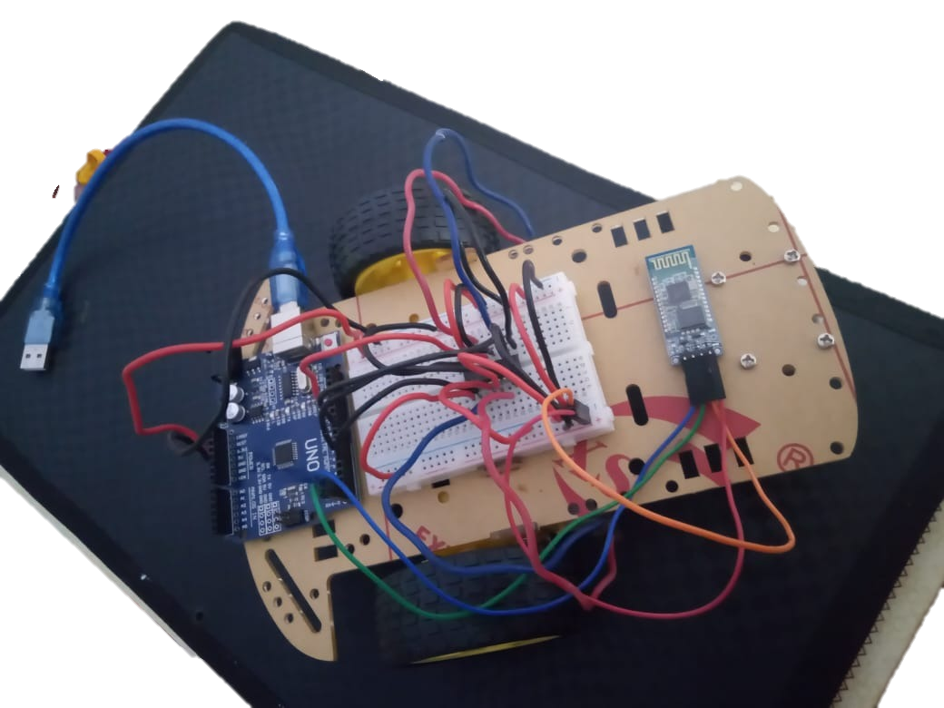
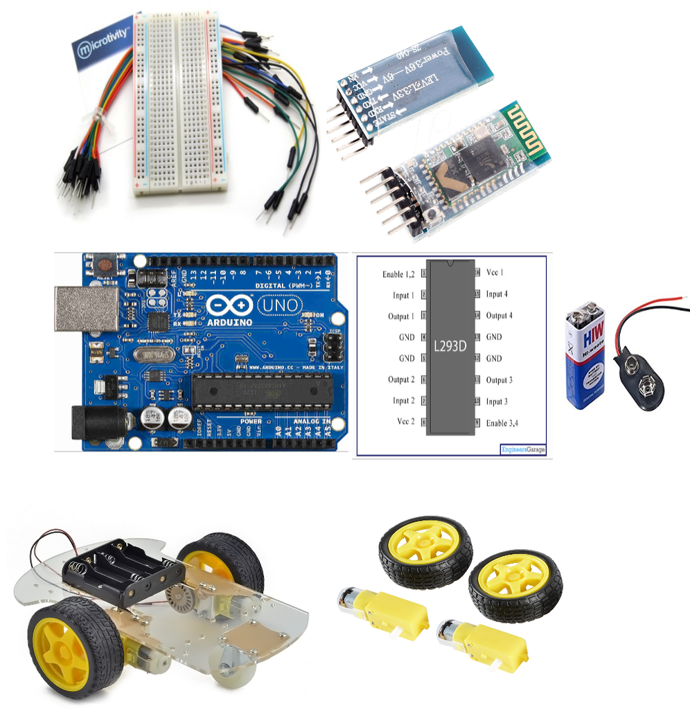
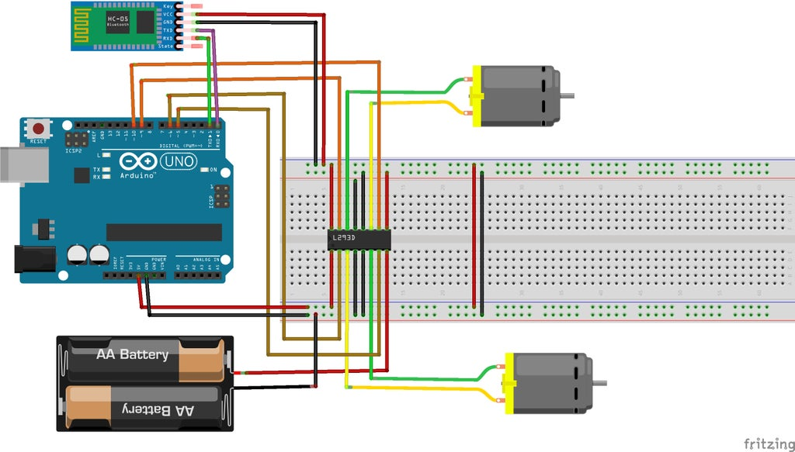
HARDWARE IMPLEMENTATION
Hardware components
Summing up of the circuit
BOT Setup
3

Slide 4
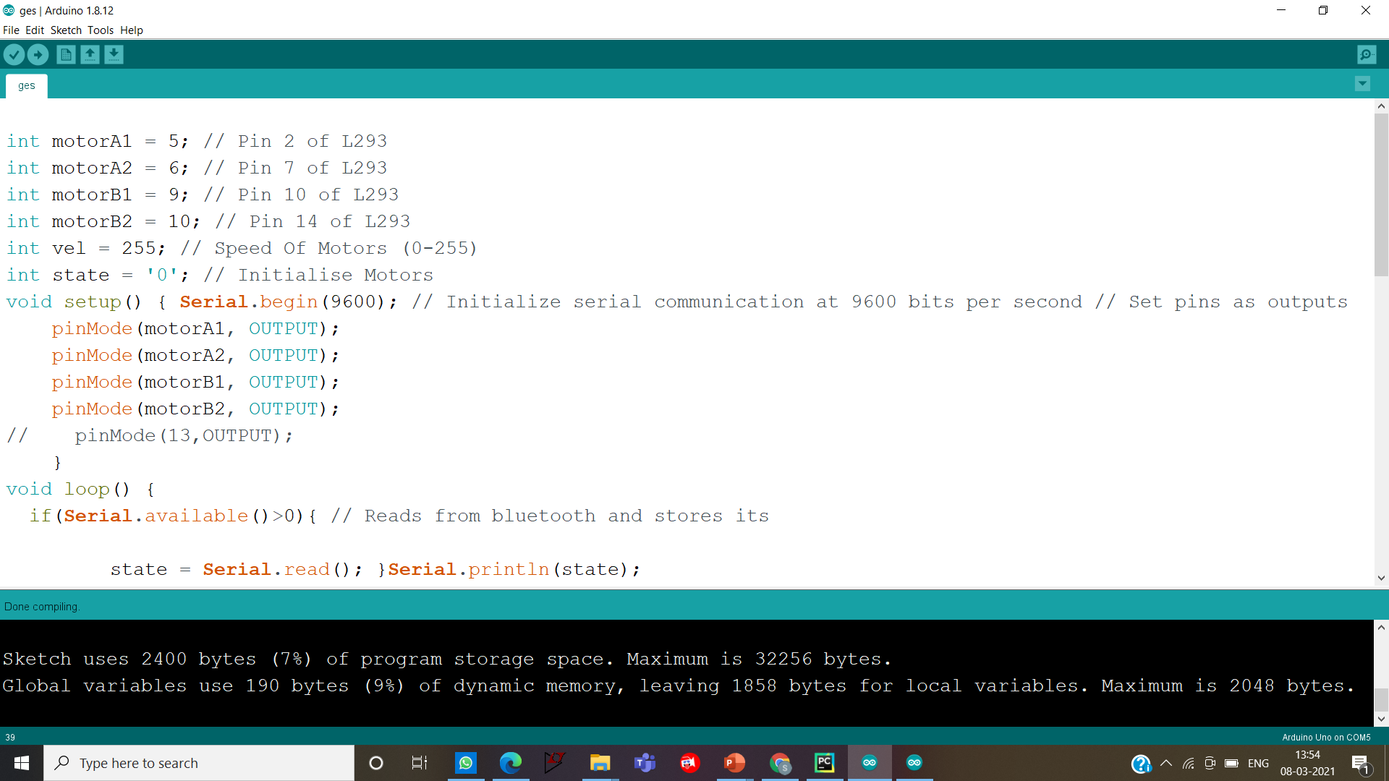
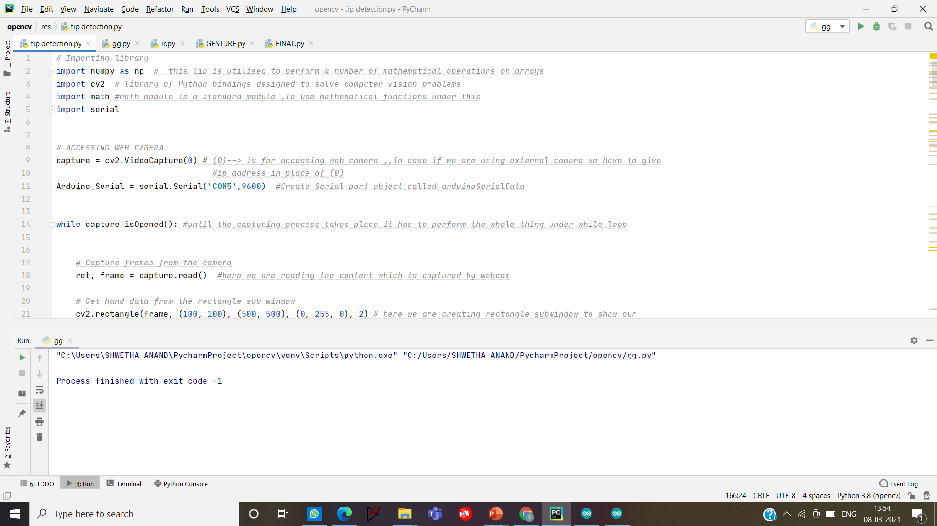
SERIAL COMMUNICATION BETWEEN BOT AND PYTHON
ARDUINO Code Editor
PYCHARM Code Editor
USING PYSERIAL LIBRARY
To communicate with ARDUINO
using PYTHON
Gesture displayed in the screen will be communicated to bot
Using HC06 Bluetooth module
OUTPUT
BOT will navigate accordingly
4

Slide 5
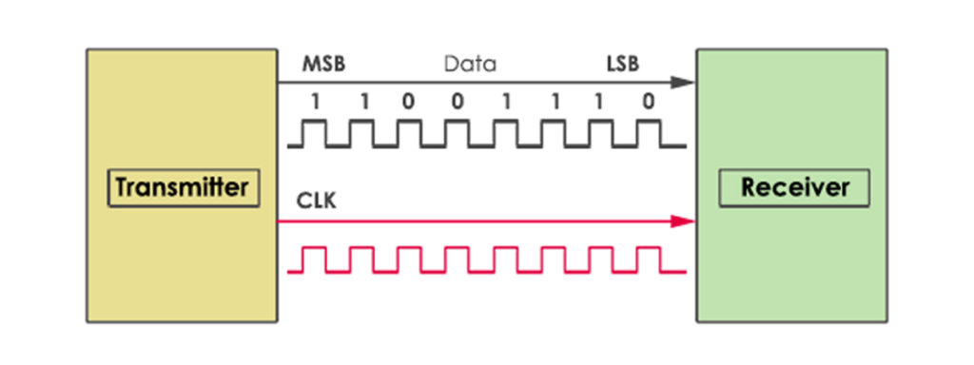
pySerial
Pyserial is a library which provides support for serial connections over a variety of different devices: old-style serial ports, Bluetooth dongles, infra-red ports, and so on. It also supports remote serial ports. This module encapsulates the access for the serial port. It provides backends for Python running on Windows, OSX, Linux. The module named "serial" automatically selects the appropriate backend. In computing, a serial port is a serial communication interface through which information transfers in or out sequentially one bit at a time.
This way we establish a connection between the Arduino and the Pycharm code which helps in the movement of bot.
5

Slide 6
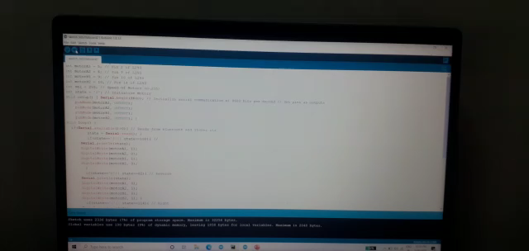
6

Slide 7
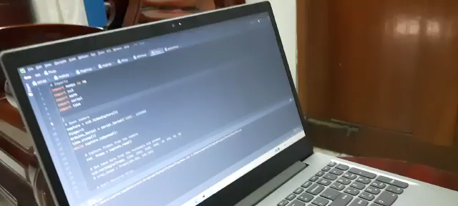
7

Slide 8
CONCLUSION:
The Gesture controlled Robot System gives an alternative way of controlling robots. We have provided a technique of finger count based gesture control, in which each finger count specifies the command for the robot to navigate in specific direction in the environment. After gesture recognition command signal and passed to the robot and it moves in specified direction. Advantages of GCR include remote surveillance,military purposes.
REFERENCES:
https://medium.com/programming-fever/how-to-find-hsv-range-of-an-object-for-computer-vision-applications-254a8eb039fc
https://create.arduino.cc/projecthub/121669/arduino-bluetooth-controlled-rc-car-9673ea
https://www.instructables.com/How-to-use-the-L293D-Motor-Driver-Arduino-Tutorial/
https://youtu.be/4F7TIwC6xZo
https://www.instructables.com/RC-Car-Using-L293D-HC-05/
8

